Slide 1
Document Layout Analysis Before Using GPT
Zehan
2023.08.24

Slide 2
Design of Document Question Answering
Task Decomposer
Agents
Search
Execute
Reason
Summarize
Retrieve
Create
Summarize this doc …
List the outline of the doc …
Document-Level Task
Embeddings
What is the conclusion of this research …
How does this model work?
Section-Level Answer
User
Built-in Prompts
Explain Figure 1 …
What does each column in Table 2 represent?
Paragraph-Level Task
Memory
What does TTA mean?
How much performance does method A improve?
Sentence-Level Task

Slide 3
Document Layout Analysis
Segmentation
Top Bottom
Retrieval
Texts (Contents, Fonts)
Multi-Modal (Contents, Regions)
Reading Order
Left Right
Machine Learning
Position
Blocks (Texts, Figures, Tables)
PyMuPDF
LayoutLMv3
LayoutReader
Paragraphs, Figures
Tables, Columns
DiT
My Solution
Priority-Grid-Rule-based Algorithm
Contexts
Semantic Search
Embedding
PyMuPDF

Slide 4
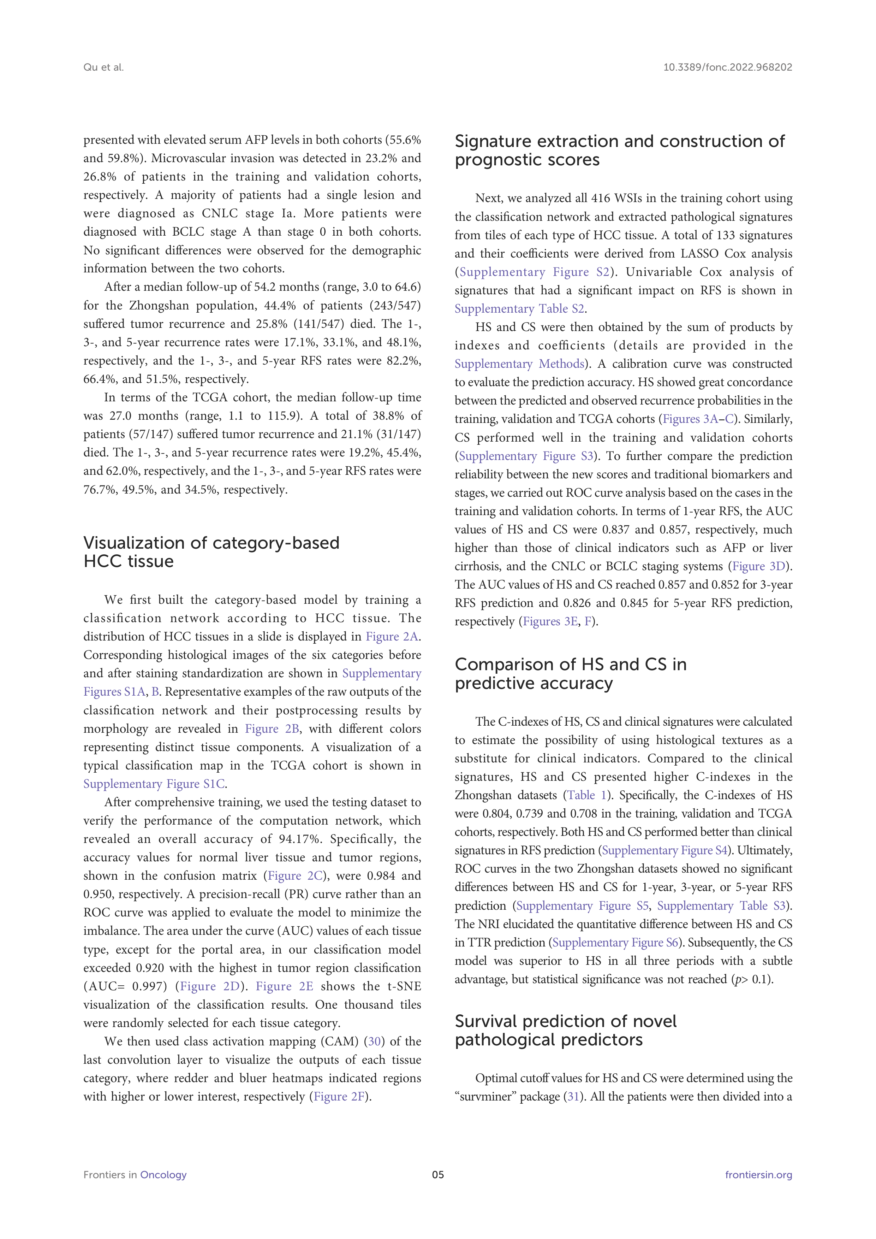
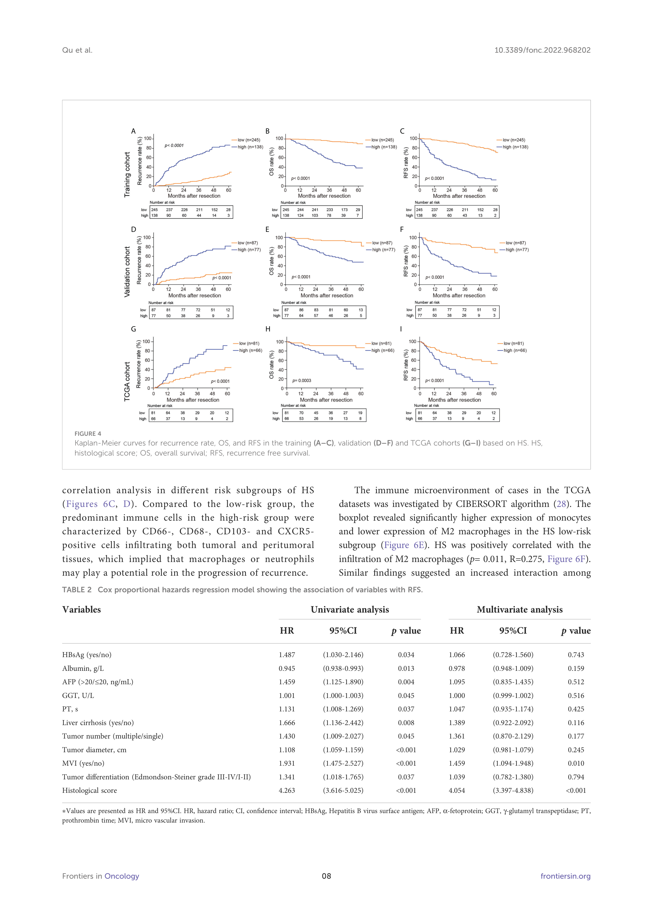
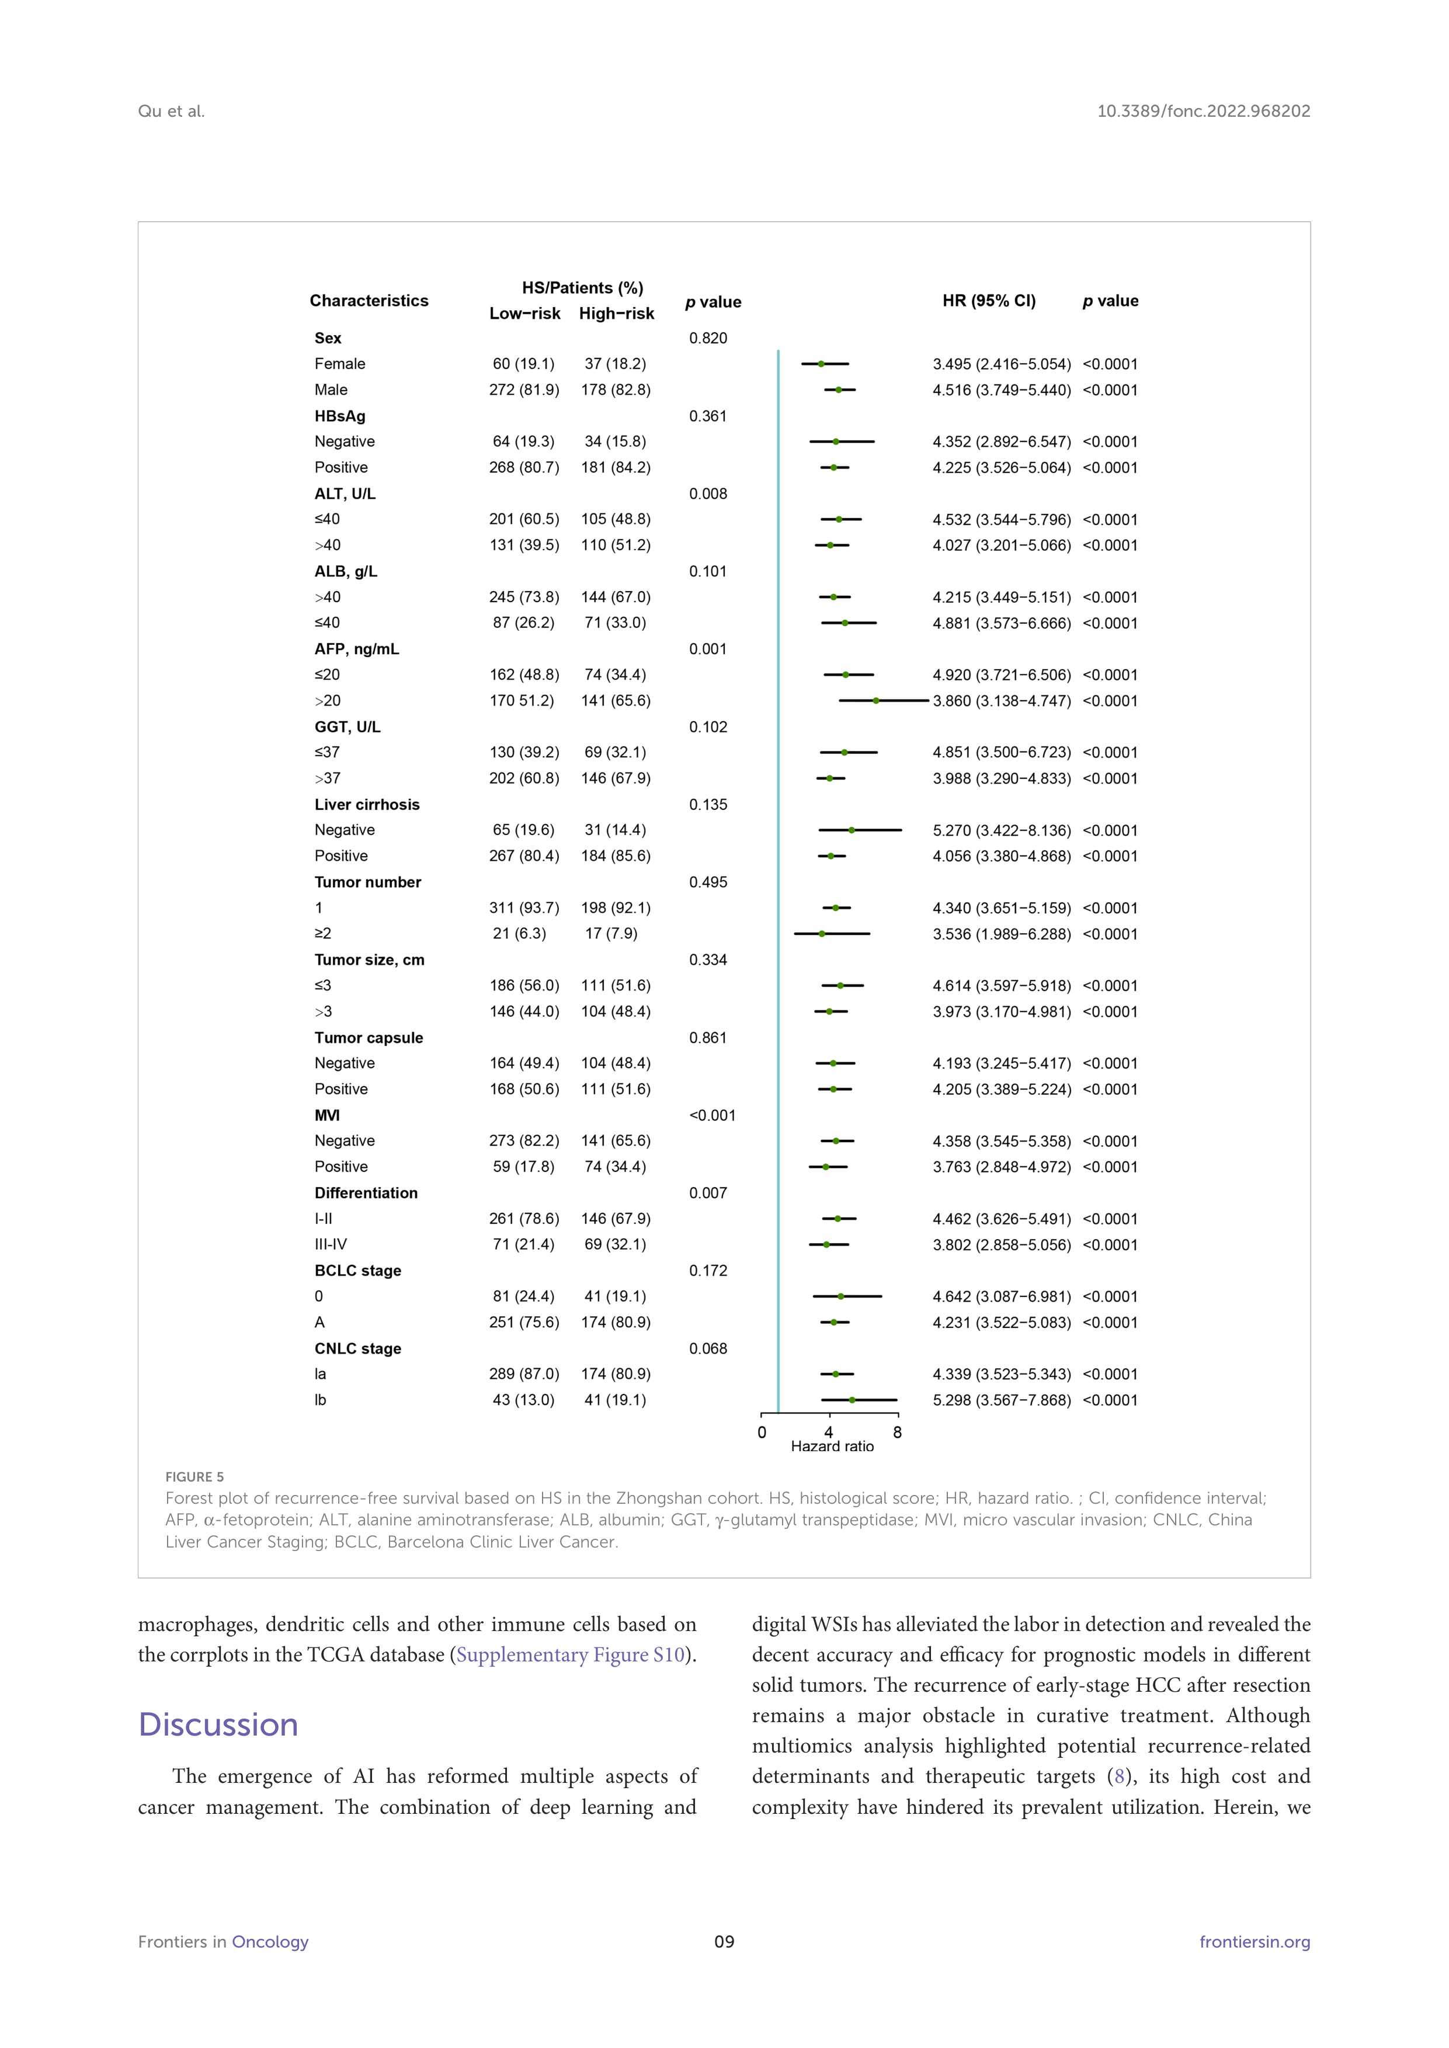
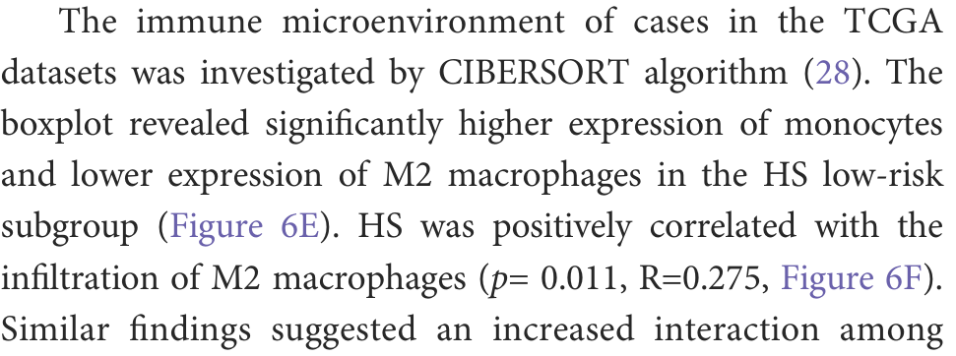
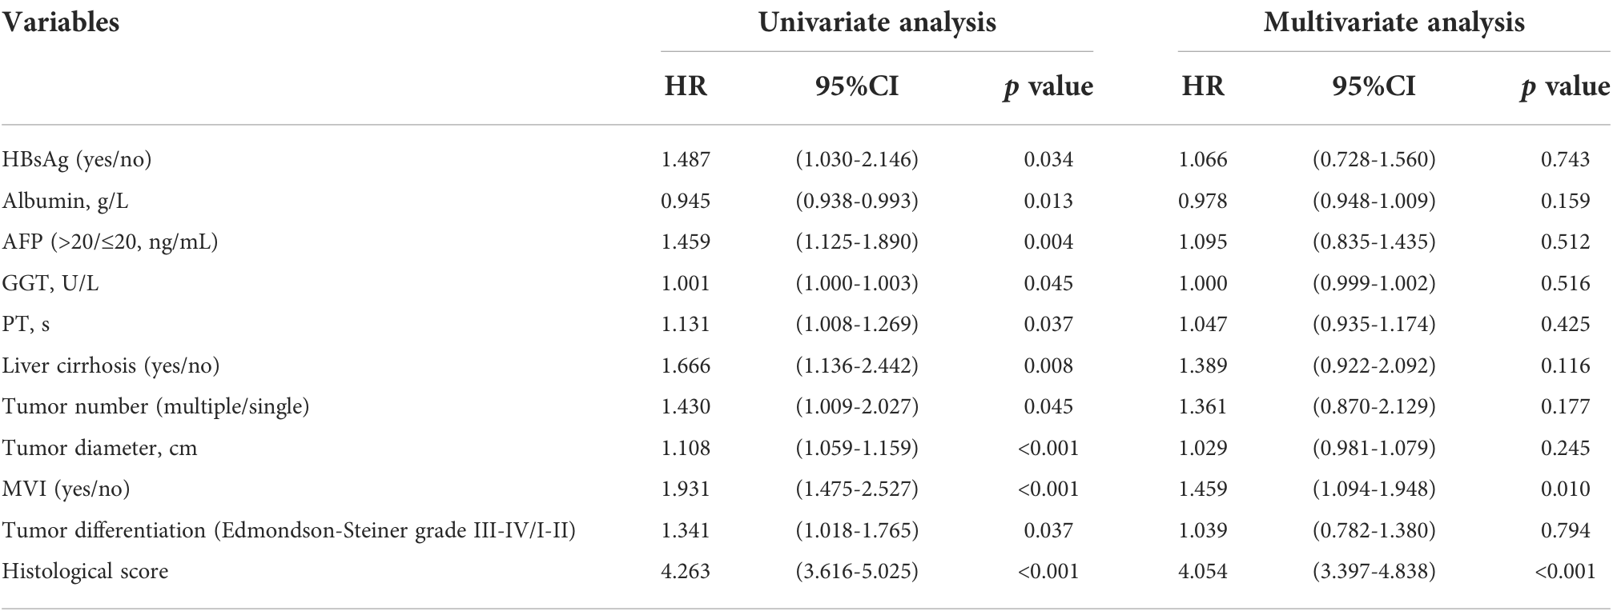
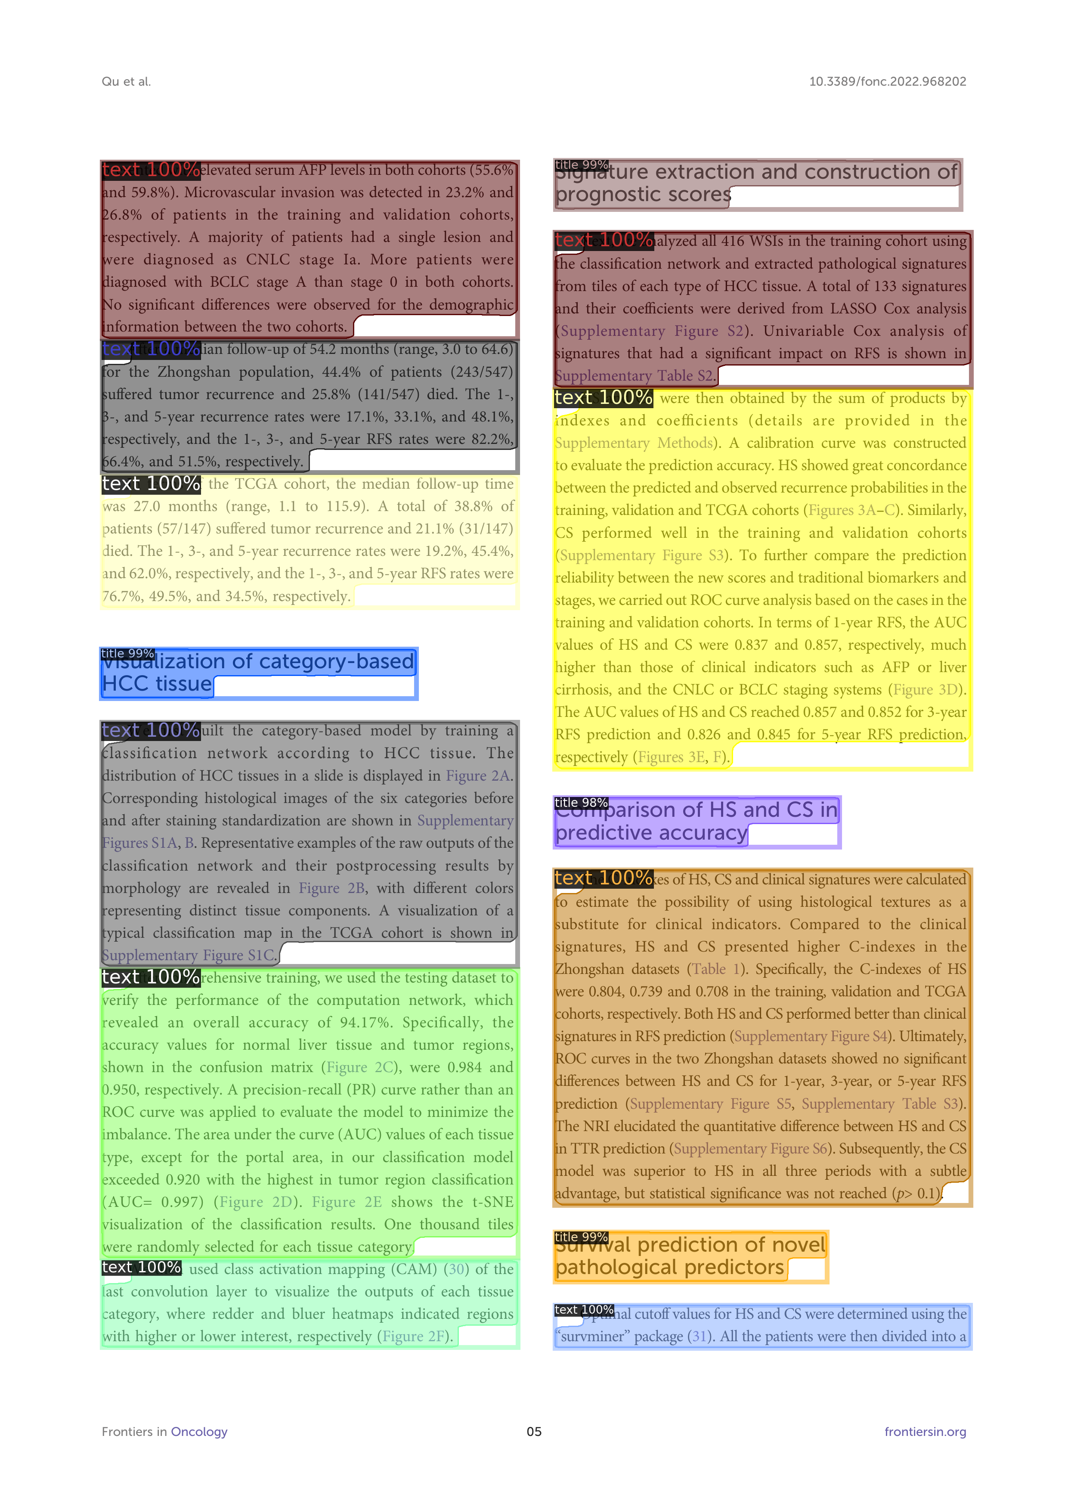
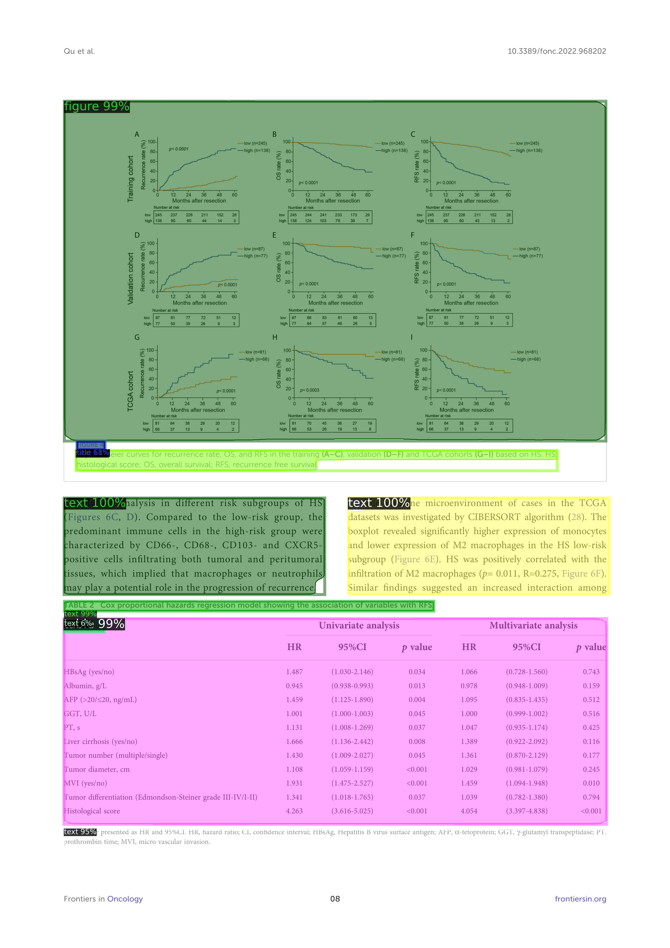
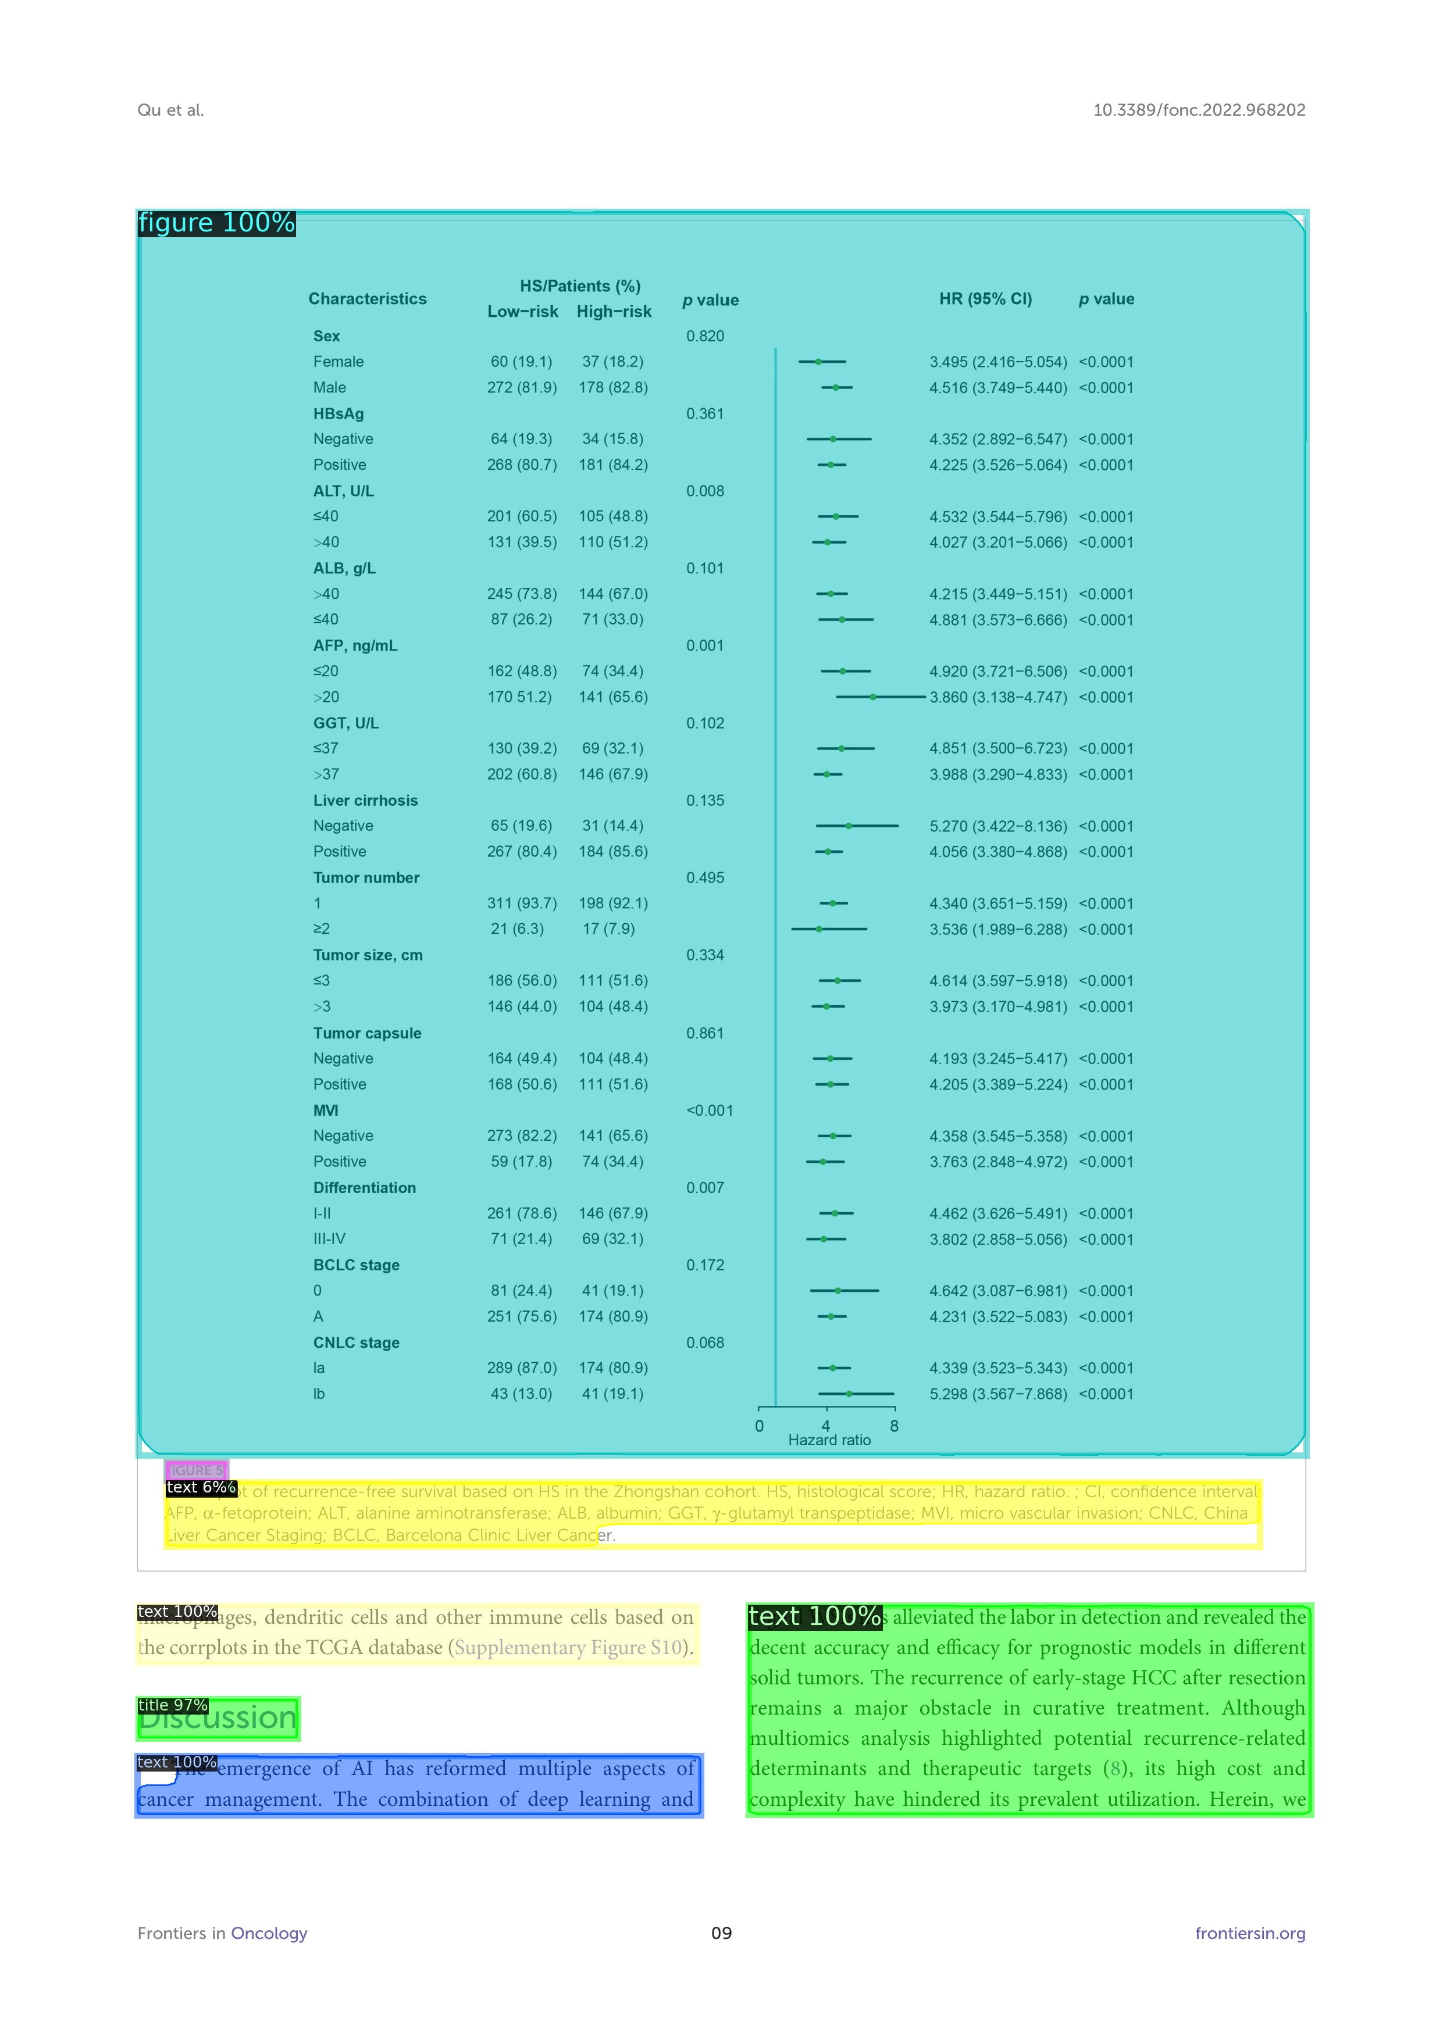
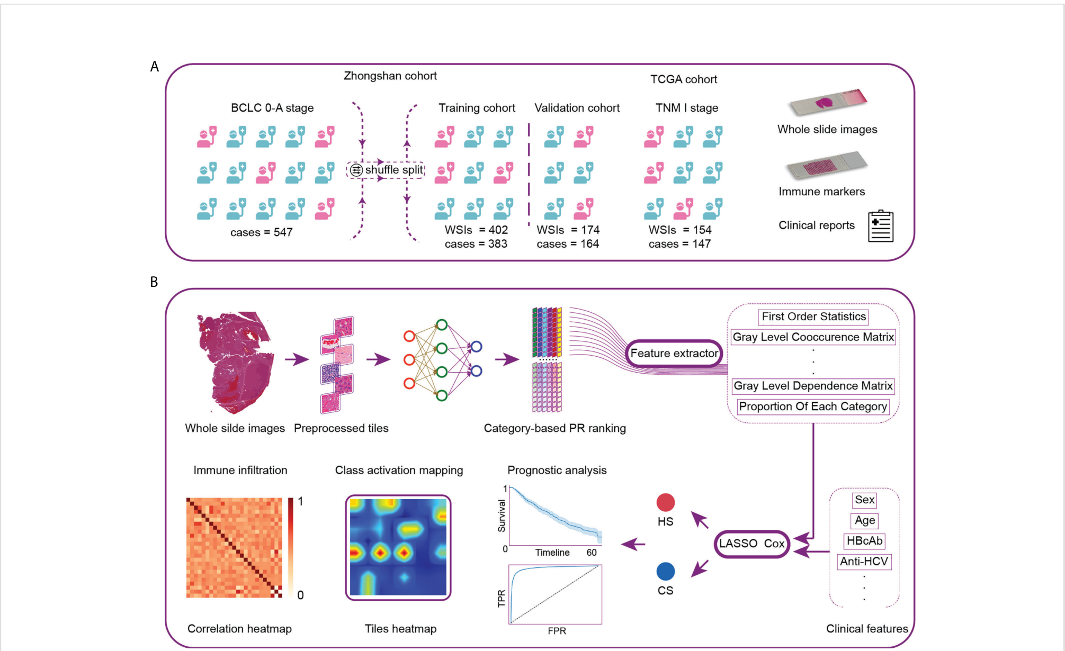
Flow of Document Layout Analysis
Page 1
Page 2
Page ?
Block 1
Block 1
Block 1
Document
Block 2
Block 2
Block 2
Sections
…
…
…
…
Embeddings
Block ?
Block ?
Block ?
Paragraphs
Sentences
Document Layout Analyzer
Document Information Organizer
Text Block
Position
Text
Table Block
Position
Table
Figure Block
Position
Figure

Slide 5
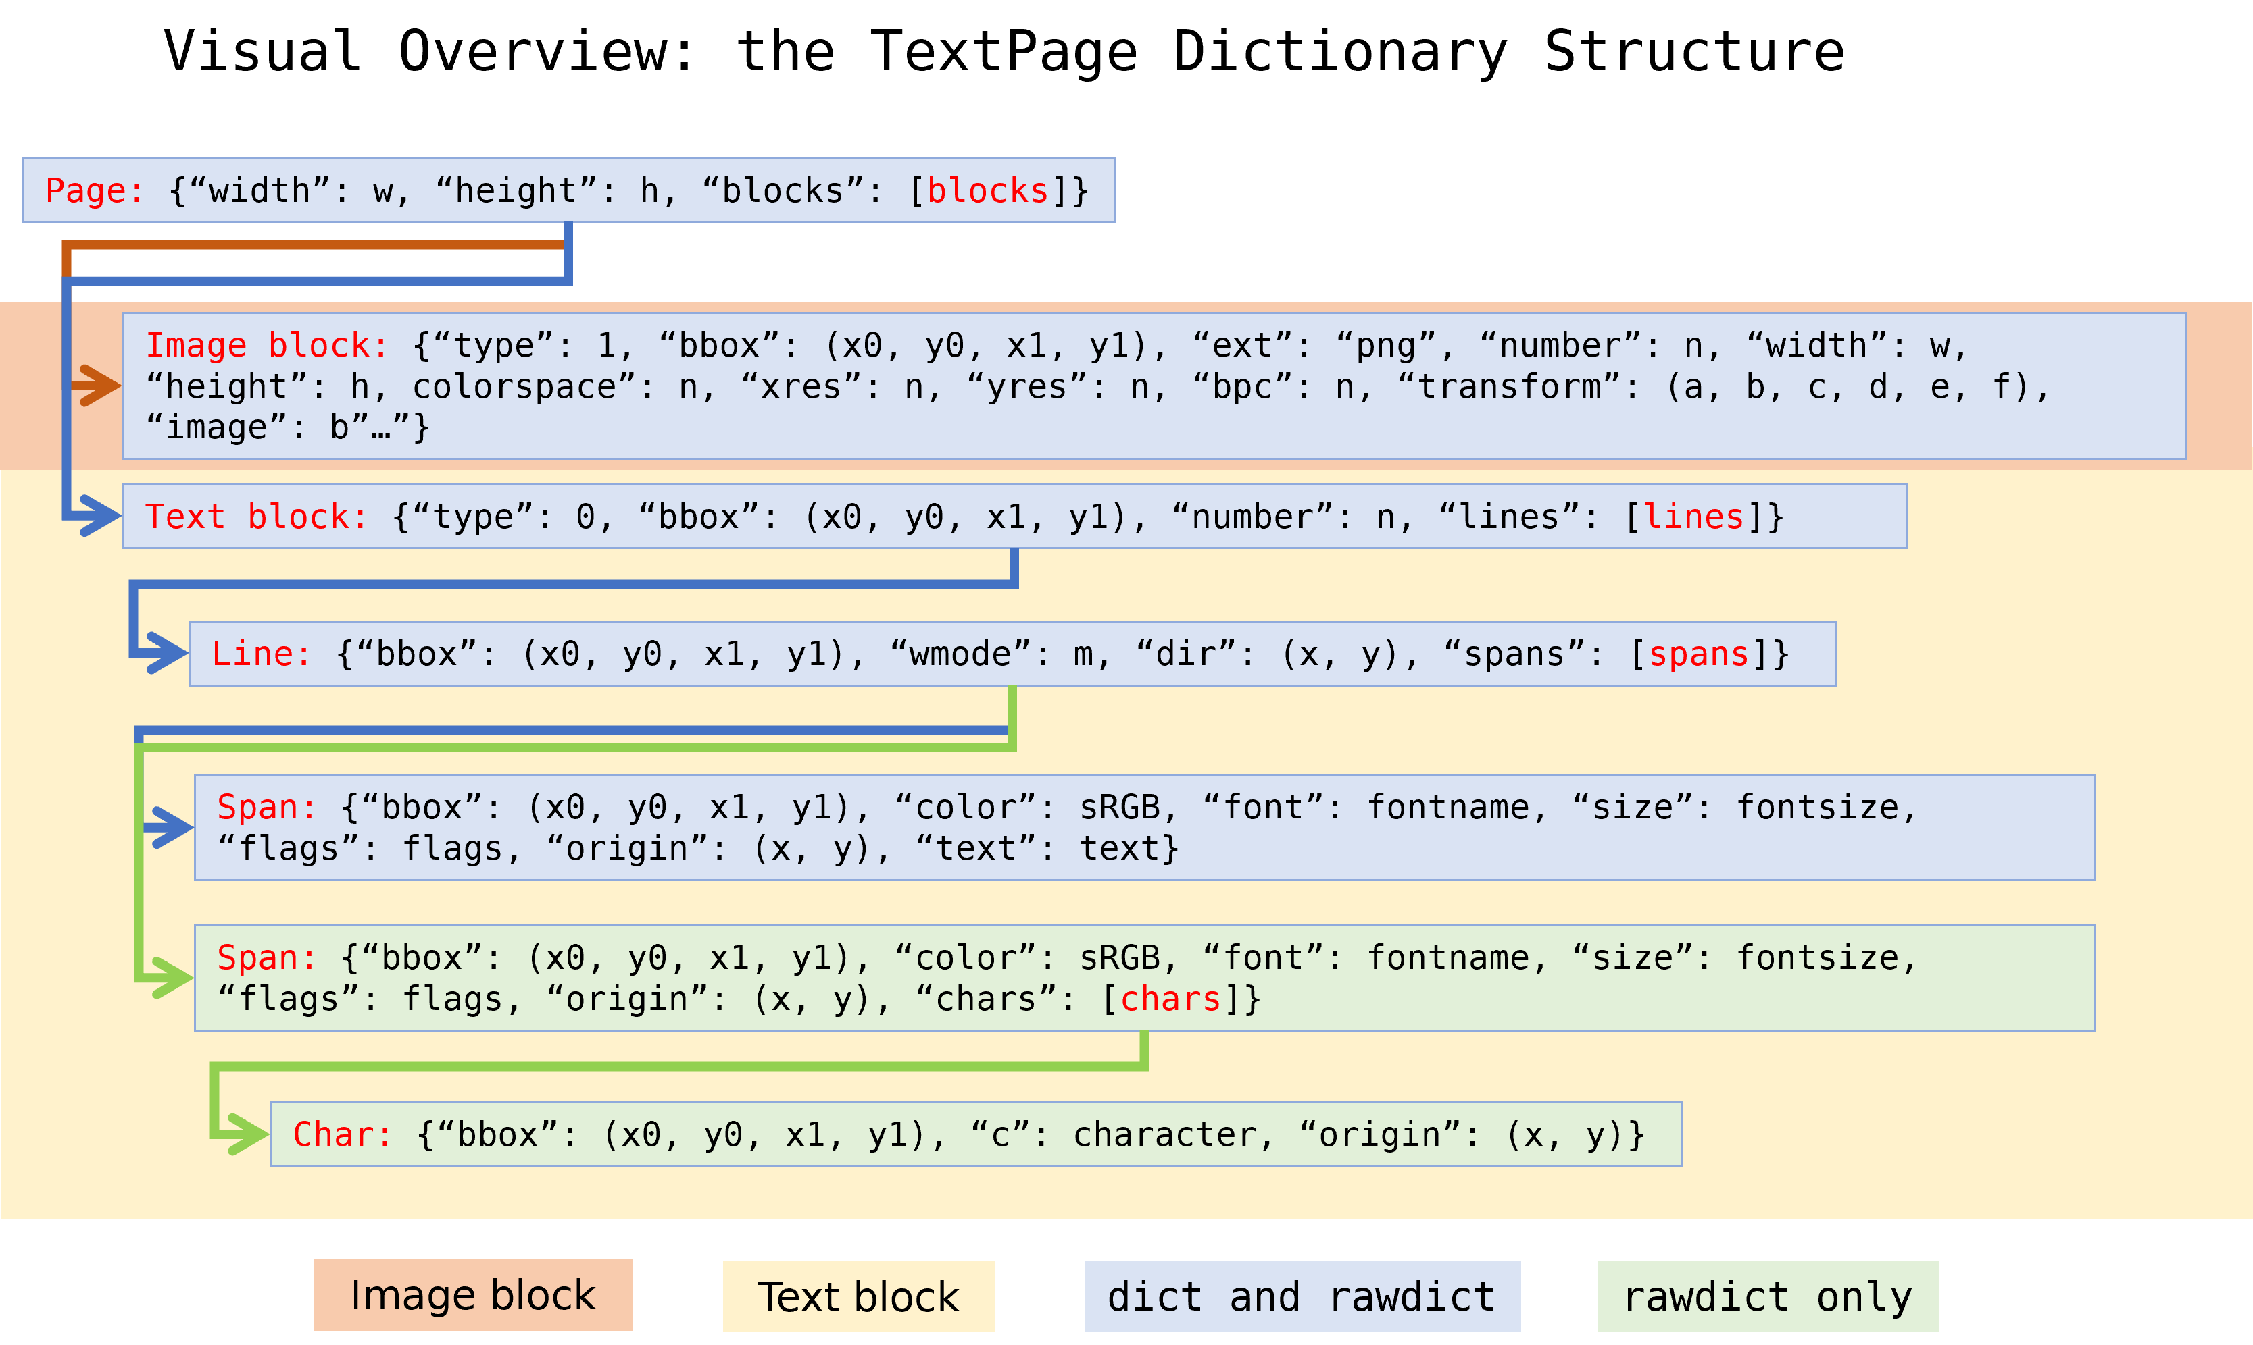
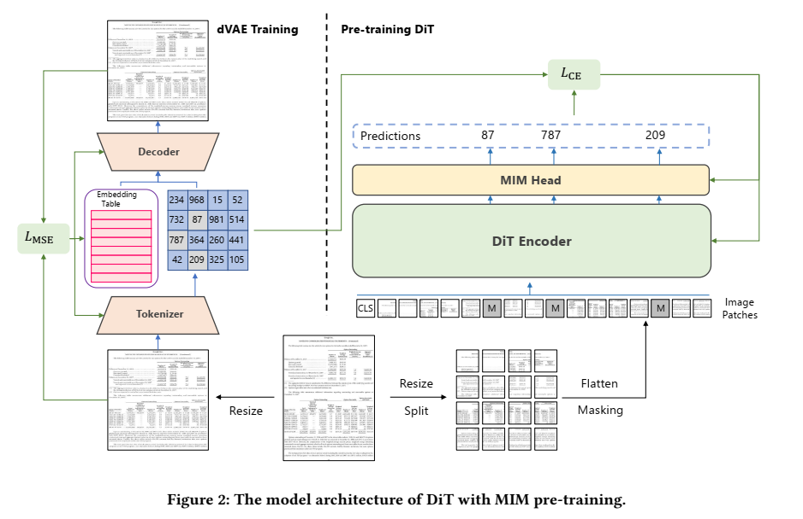
Page Blocks Dict with PyMuPDF
Architecture of DiT

